Slide 1
The Motherhood Penalty: Universal Two-Child Policy and Analyst Forecasts
Weixing Cai, Yuqi Pu,
Cheng Zeng, and Jing Zhao
June 2023
Hang Seng University of Hong Kong

Slide 2
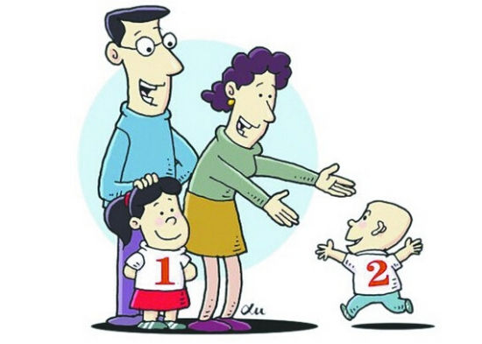
The Universal Two-Child Policy

Slide 3
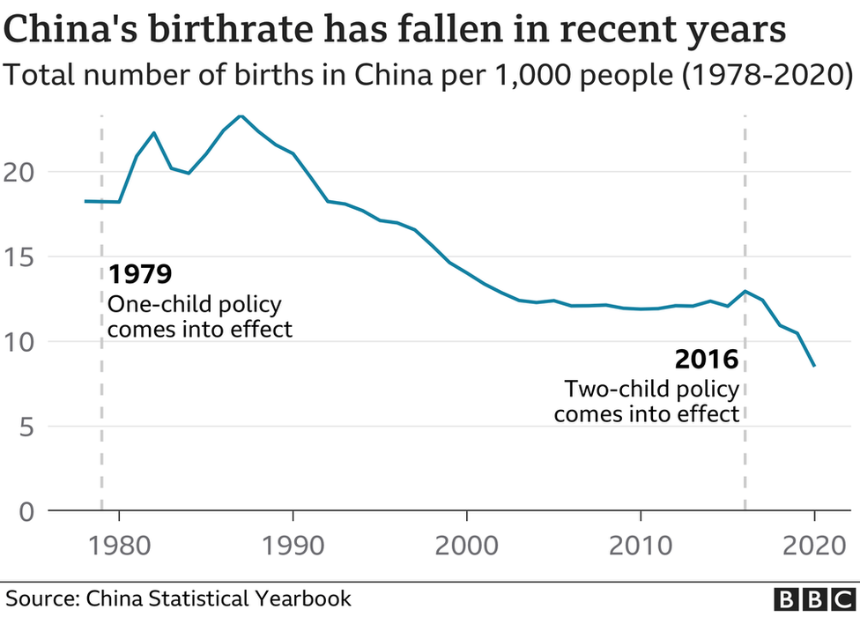
First formal statement of the two-child policy was in Oct 2015.
The law was passed in Dec 2015.

Slide 4
The Universal Two-Child Policy
In 2016, China introduced a universal two-child policy, which relaxed the previous one-child policy that restricted many families to a single child between 1980 and 2015.
After the policy shock, the salary of female new hires is reduced by 1.8% relative to the salary of male new hires, equivalent to a 34% increase in the gender wage gap in the data (Agarwal, Li, Qin, and Wu, 2022).
Using a two-wave nationwide correspondence experiment, women—but not men—are subject to labor market discrimination for expected family responsibilities. (He, Li, and Han 2023; Li, Wen, Ye, and Yu, 2022).
Why do women experience increased labor-market discrimination?

Slide 5
Research Questions
Do childcare responsibilities affect (female) analysts’ forecasts?
    Use the 2016 Two-child Policy Reform as an exogenous shock to the childcare responsibilities born by female analysts.
    Forecast accuracy, effort, timeliness, etc.
What could be the mitigating factors?
    Examine the resource support from their labor force
Do childcare responsibilities affect (female) analysts’ career outcomes?
    Promotion to Star
    Exit from the job market (as a sell-side equity analyst)

Slide 6
Why Do We Focus on Analysts?
The profession of sell-side equity analysts presents a unique context to study the effect of the Two-child Policy on the labor market productivity.
Analysts’ work productivity is quantifiable and comparable based on their forecast accuracy and timeliness.
    Green and Clifton (2014); Brown and Lawrence (2015)
Sell-side equity analysts are key players in the financial market.
    Gather information and evaluate the prospects of public firms
    Forecast firms’ future earnings (Mikhail, Walther, and Willis 1999)
    The quality of their work significantly impacts the information environment (Asquith, Mikhail, and Au, 2005; Li and You, 2015).

Slide 7
Why Do We Focus on Analysts?
A large proportion of female analysts are at their peak reproductive years:
    72% of female analysts are 30-40 years old
Analysts’ work is well renumerated, such that they are likely to be able to afford having two kids.

Slide 8
Main Findings (RQ1)
After the Two-Child Policy Reform, female analysts’ forecast accuracy decreases by 12.3% more than male analysts.
    Female analysts’ forecast frequency and timeliness also decrease.
    Robust to an alternative setting with staggered maternity leave reform
The effect is stronger when the forecasting difficulty is higher (Bradshaw, Lee, and Peterson, 2016).
    Firms with a wider business scope and more intangible assets
The effect is stronger when the local fertility culture is stronger.
    Provinces with a higher birth rate, fertility willingness (CGSS), and gender inequality culture (Baidu Search volume for “prefer son over daughter”)

Slide 9
Main Findings (RQ2)
Previous papers show that childcare resources improves women’s employment and career choices (Waldfogel, 2002).
    Women in high childcare areas are more likely to be promoted to managerial positions and higher levels in the job ladder (Chhaochharia, Ghosh, Niessen-Ruenzi, and Schneider, 2022) .
The effect of the Two-Child Policy is smaller when analysts are more likely to afford childcare services (External Support).
    When analysts reach to the Star analysts’ position
    When they work in a top broker
The effect of the Two-Child Policy is smaller when analysts can gain support from their brokers (Internal Support).
    When analysts work with a larger team
Notes:
Chhaochharia, Ghosh, Niessen-Ruenzi, and Schneider, 2022: new mothers in high childcare counties in Germany experience a 25% smaller earnings penalty than new mothers in low child care counties. This difference comes from three margins: mothers in high child care counties work more days (32%), are less likely to switch to a part-time position (11%), and less likely to leave the workforce completely (26%)

Slide 10
Main Findings (RQ3)
Following the Two-Child Policy, female analysts experience a stronger labor-market discrimination.
Female analysts are less likely to be promoted to a Star analyst and are more likely to exit their job (as a sell-side equity analyst).

Slide 11
Contribution
Our findings add to the understanding of the impact of the Two-Child Policy to the financial market.
Many recent papers on the effect of Two-Child Policy focus on social status and labor-market outcome.
  After the policy shock, female workers are less likely to receive interview callbacks and their salary reduce by more compared with male workers. (He, Li, and Han, 2023; Li, Wen, Ye, and Yu, 2022; Agarwal, Li, Qin, and Wu, 2022).
  Female students anticipate the poorer future job prospects and reduce loan applications from P2P lending platform as well as subsequent human-capital investment (Choi, Gao, Lam, Li, and Qian, 2023).
Differing from other papers that document an unequal impact of the Two-Child Policy on men and women, this paper focuses on financial analysts, whose productivity potentially affects the information environment of the financial market.

Slide 12
Contribution
Our paper is closely related to the recent papers that document on the effect of Covid-19 on labor productivity.
  Covid-19 has witnessed social distancing and school closures in 2020.
  Female Workers: Alon, Doepke, Olmstead-Rumsey, and Tertilt (2020)
  Female Researchers: Barber, Jiang, Morse, Puri, Tookes, Werner (2021)
  Female Analysts: Li and Wang (2022) and Du (2023)
Differing from a wide-spread yet temporary shock of childcare responsibilities imposed by the Covid-19, the Two-Child Policy in China has a long-lasting impact on additional childcare responsibilities.
  Has the potential to affect the career outcomes of analysts
Our paper also has important policy implications: Supporting resources in the work environment significantly mitigate the impact of motherhood penalty.

Slide 13
Contribution
Adds to the discussion on Belief-based v.s. Taste-based explanation for gender discrimination
  The literature suggests that women have a lower productivity and financial literacy than man (Arrow, 1973; Bertrand, 2010, 2016, and 2020).
  Belief-based discrimination indicates that brokers attribute to the analysts the traits of their average group member.
  Taste-based discrimination indicates that brokers have a specific distaste for female analysts, then they would suffer a lower psychic cost when they gave women less career opportunities.
The literature has generally required datasets with repeated interactions to differentiate belief-based and taste-based discrimination (since belief-based discrimination results from information asymmetry, which may decline over repeated interactions). (Bohren, Imas, and Rosenberg, 2019)
Instead, the unique policy reform in China allows us to examine the belief-based v.s. taste-based discrimination hypotheses with a one-shot exogenous shock to the productivity of female analysts.

Slide 14
Data
Sample Period: 2012-2020
CNRDS
  Earnings per share (EPS) forecast reports
  Actual company EPS data
  Analyst personal data: name, gender, highest education, start time of work, and university enrollment date.
  We infer the age of an analyst assuming that analysts were 18 when entering university.
  We choose the analysts aged 30-40 in 2016 for our baseline results.
CSMAR
  Financial information
  Shareholding information
There are in total 310,006 observations at the analyst-firm-year-report level, including 85,004 for female groups and 225,002 for male groups.

Slide 15
Data

Slide 16
Measures
Analyst Forecast Accuracy
  EPSerror: the absolute value of the company's actual EPS minus the analyst's EPS forecast divided by the absolute value of the actual EPS
  Extreme_EPSerror: Equals 1 if higher than the 75th quantile of EPSerror.
Analyst Forecast Frequency
  Number of forecast reports
  Number of forecast revisions
  Interval between forecast revisions
Analyst Forecast Timeliness
  Equals 1 if an analyst issued an EPS forecast within days [0, +1] following a firm’s quarterly or annual earnings announcement.

Slide 17
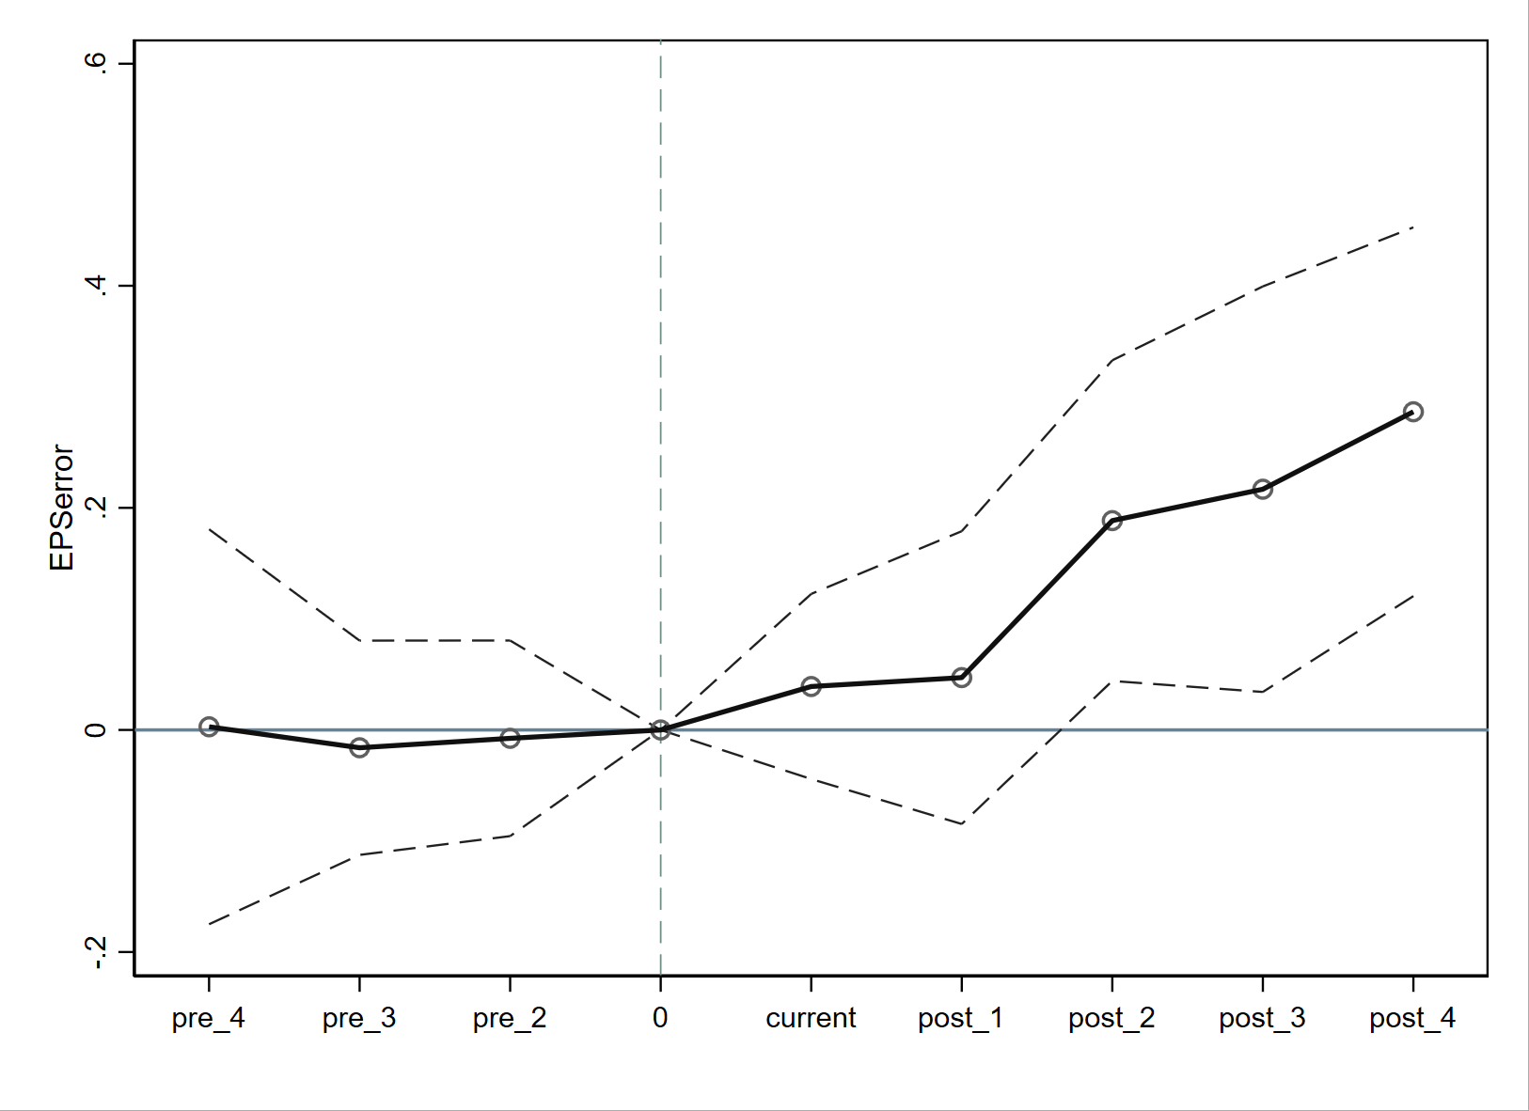
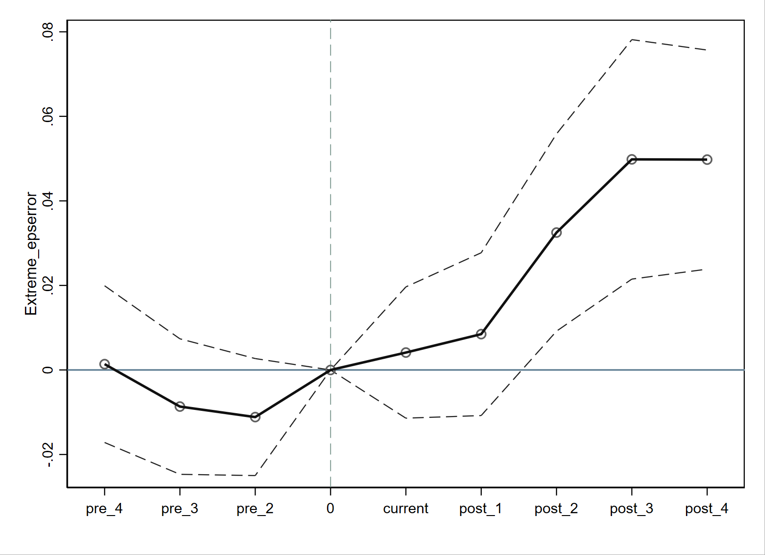
Baseline Results
Following the Two-Child Policy, female analysts’ forecast errors increase more than male analysts.

Slide 18
Baseline Results

Slide 19
Dynamic Analyses

Slide 20
Analysts’ Forecast Frequency and Timeliness

Slide 21
A Potential Concern
The Universal Two-Child Policy is a one-time shock.
This policy may lead to temporary economic shocks on household consumptions, which may somehow affect female and male workers asymmetrically.
It is possible that the policy affects analysts’ forecasts via the economic shocks, not via child-bearing activities of analysts.
If this is the case, we should observe a similar result for analysts that are less likely to have a second child, i.e., those aged less than 30 or above 40.

Slide 22
Placebo Tests

Slide 23
An Alternative Setting – Maternity Leave Reform

Slide 24
The Role of Forecasting Difficulty

Slide 25
The Role of Forecasting Difficulty

Slide 26
The Role of Local Fertility Culture

Slide 27
The Role of Local Fertility Culture

Slide 28
The Role of Local Fertility Culture

Slide 29
The Role of Supporting Resources
Previous papers show that childcare resources improves women’s employment and career choices (Waldfogel, 2002).
    Women in high childcare areas are more likely to be promoted to managerial positions and higher levels in the job ladder (Chhaochharia, Ghosh, Niessen-Ruenzi, and Schneider, 2022) .
The effect of External Support: affordability to childcare services.
    When analysts reach to the Star analysts’ position
    When they work in a top broker
The effect of Internal Support: accessibility to team collaborations.
    When analysts work with a larger team
Notes:
Chhaochharia, Ghosh, Niessen-Ruenzi, and Schneider, 2022: new mothers in high childcare counties in Germany experience a 25% smaller earnings penalty than new mothers in low child care counties. This difference comes from three margins: mothers in high child care counties work more days (32%), are less likely to switch to a part-time position (11%), and less likely to leave the workforce completely (26%)

Slide 30
External Support: Affordability to Childcare Service

Slide 31
External Support: Affordability to Childcare Service

Slide 32
Internal Support: Accessibility to Team Collaboration

Slide 33
Two-Child Policy and Analysts’ Career Outcomes
Two-Child Policy may have implications for labor-market discrimination.
  After the policy shock, female workers are less likely to receive interview callbacks and their salary reduce by more compared with male workers. (He, Li, and Han, 2023; Li, Wen, Ye, and Yu, 2022; Agarwal, Li, Qin, and Wu, 2022).
  Female students anticipate the poorer future job prospects and reduce loan applications from P2P lending platform as well as subsequent human-capital investment (Choi, Gao, Lam, Li, and Qian, 2023).
We examine the effect of Two-Child Policy on the probability of
  Promotion to Star
  Exit from the job market (as a sell-side equity analyst)

Slide 34
Two-Child Policy and Analysts’ Career Outcomes

Slide 35
Conclusion
Our paper documents an unintended outcome of the Universal Two-Child Policy Reform in China.
The Motherhood Penalty: Increased childcaring responsibilities asymmetrically affects the productivity of female and male analysts.
Female analysts face more formidable glass ceilings following the Two-Child Policy Reform.
Supporting recourses, such as teamwork collaborations, help mitigate the effect of motherhood penalty.

Slide 36

The New Three-Child Policy in 2021

Slide 37


