Slide 1
Getting a good start on your paper: Writing up and organizing the introduction
HSU RIB (research institute of business) theme-based research seminars -- May 9, 2023
The Hang Seng University of Hong Kong
Hang Shin Link, Siu Lek Yuen,
Shatin, N.T Hong Kong SAR
David Ahlstrom
--Professor – The Chinese University of Hong Kong
Guest Senior Editor—Journal of World Business
Consulting Editor (and former Editor-in-Chief), Asia Pacific Journal of Management
ahlstrom@cuhk.edu.hk
Notes:
1

Slide 2
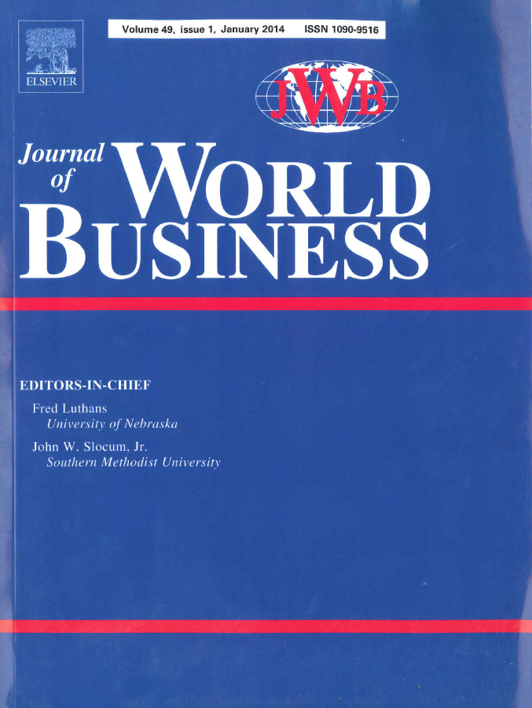
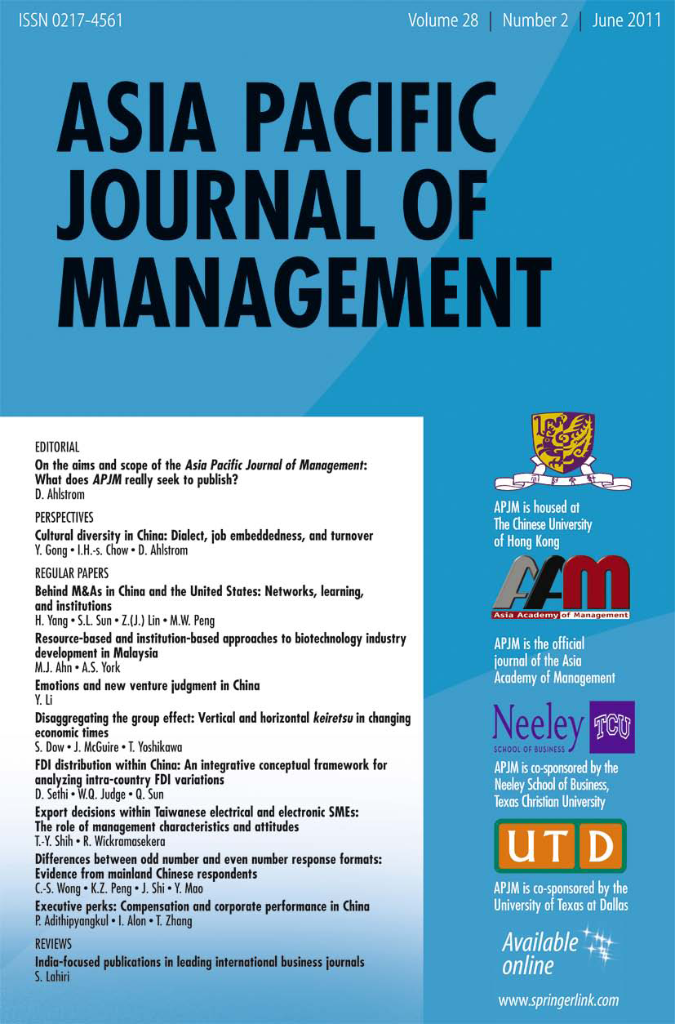

Slide 3
Getting an article published
Discuss
later
Generating a paper Idea and its framing
Designing the Study
Getting Data and analyzing it
Starting and organizing
your paper
Formatting and submitting
the Paper (and selecting the
journals and related details)
6. Reviewers + revisions [covered separately]
Our
Focus

Slide 4
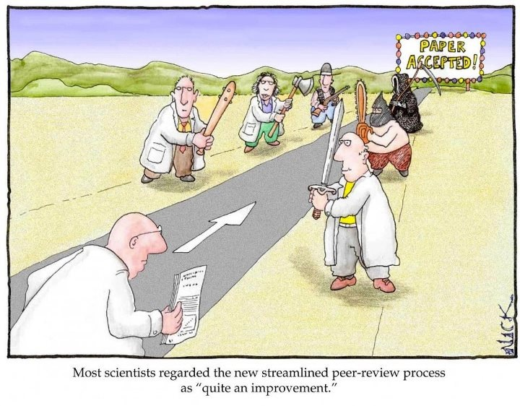

Slide 5
Publishing papers is not magic -- First we’ll deal with organizing your manuscript (especially the introduction) – and especially being direct and clear with your theory / framing and contributions.
Notes:
5

Slide 6
Helpful paper handouts

Slide 8
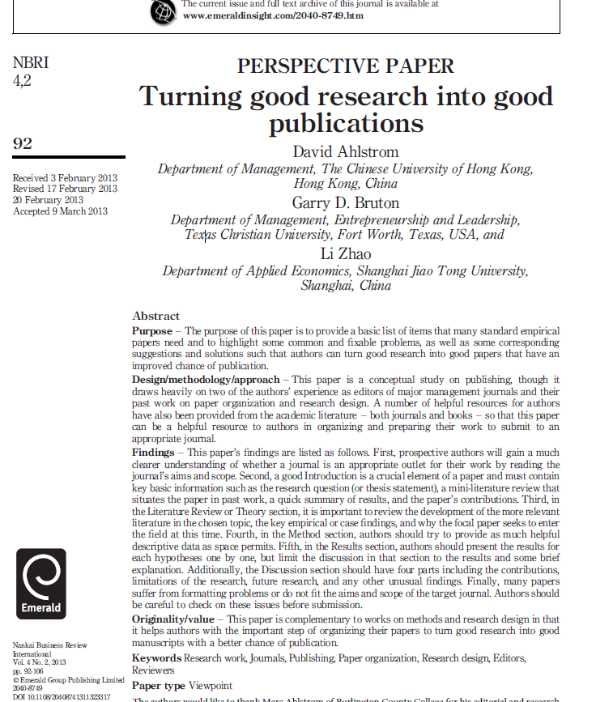

Slide 9
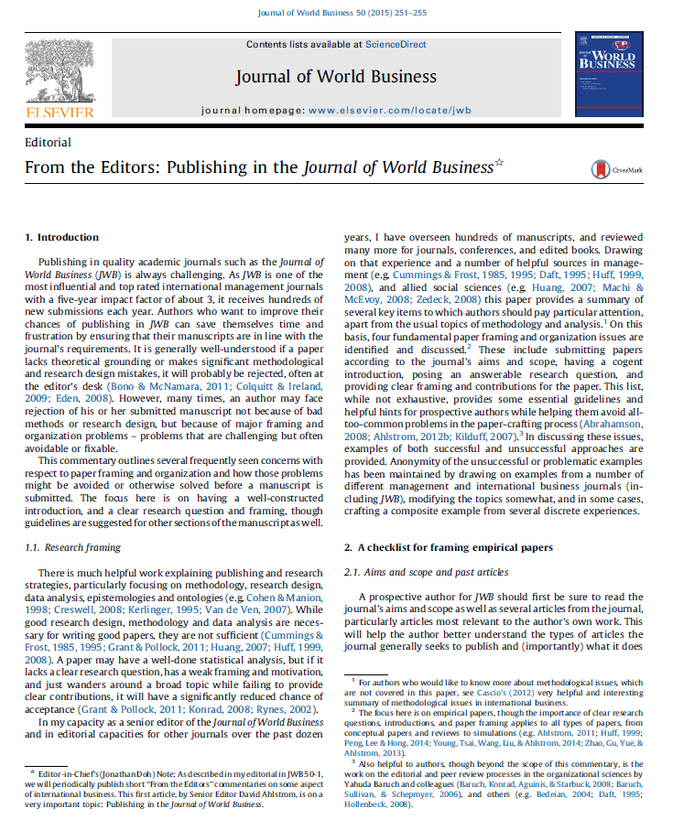

Slide 11
Paper organization: How articles in the best journals are organized and what do they contain
We conducted a content analysis of AMJ for the last three years in terms of how the articles were organized and what components they usually contained.
Checked this with some other major journals (like SMJ).
Further checked the emerging pattern with editorials and commentary articles in the top management journals.
Interviewed several well-published scholars about the pattern of paper organization and on the content of the better (published) management journals.
Also kept track of my own editorial experiences over the past 20 years
Summarized the common sections of empirical / case papers in our best journals (especially AMJ and SMJ, some psychology and economics)

Slide 12
Summary results of that study: Paper organization and checklist summary for empirical papers-1→ 11 main points
Aims and Scope of the journal (or of your thesis committee)
Keep your title short. If you can, use a question in the title.
Abstract & Key Words - the abstract may be the only part of the paper people read as they scan numerous papers for the information, evidence or citations they need. Think about Google or Baidu search results.
The Introduction is very important. Finish the Introduction section (or introductory part) in about 2-3 pages (about 5-7 paragraphs) More on introduction:
4a) What is your research question? Frame research in terms of a question. (more on that later) Put it in Introduction (not on page 10, for example).
4b) Situate your paper in past literature and then motivate the paper –the mini-literature review (in the Introduction). Usually 2-3 paragraphs here.
4c) Brief hypotheses +research design / methods (in Introduction – also about 1 paragraph for each of those two items). Be sure to mention your dependent variable clearly and at least one key independent variable.
4d) What do the results of your paper contribute (briefly in the Introduction, expanded in the Discussion section later). Contributions are what you found & how does it improve theory, evidence, and practice (not just what you did).
Some finish the introduction with the list of what they will do next. Usually no need for this unless the paper is unusually complicated. Don’t waste space.
Notes:
12

Slide 13
Paper organization checklist summary-2 (after the Introduction section)
After the Introduction section:
5) Literature review (Theory) should tell a story / progression of the literature’s development. More detail on this later w/topic selection.
Basically, a good literature review helps your paper:
to convince reviewers and editors that you know the literature.
to situate / locate / position (editors also sometimes say “motivate”) your paper properly.
to enter the research program (research stream) in the ‘right place.’
That is, if the field is well-developed, probably a case study or qualitative paper will not be easy to “sell” to editors / reviewers.
d) Sometimes, you might need a section that explains something about the research site (i.e. the auto industry in China and Europe). This usually will come after the general theory and past literature that covers the main (theory-research) topical area
6) If you have hypotheses, you usually need 1-2 paragraphs per hypothesis. Don’t list hypotheses. Don’t put into a table only.

Slide 14
Table 1 from Ahlstrom+ Wang, 2020) - Structuring the introduction section of empiri-cal papers in Mgt+IB
(also see
Meyer et al., 2009: 61-62 – next slides)
Question

Slide 15
Title is straight-forward.
Research question is first sentence
Quickly, the other research is summarized (systematically, not just listed, but by general group of papers).
The first 3 paragraphs show how there is other research, but it is not enough (and why it is not enough)

Slide 16
(End of) Paragraph 3 repeats the research question in more detail (i.e. “Given these {hypothesized} institutional differences, how do foreign firms adapt entry strategies when entering emerging economies?)
The research question is now (re)stated more like an hypothesis {given this hypothesis question} and its conditions-detail is added {institutions, emerging economies}
Paragraph 4 – then states the broad propositions and the paper’s motivation(past calls for research) and position (‘we thus depart from much existing literature’).
Paragraph 5 – mini-methods summary
Paragraph 6 – contributions (theory, empirical or case evidence, practice, research methods)
Note: No “list” (first we do this, second we do that…”)

Slide 17
Paper organization checklist summary-3 (the rest of the paper)
7) Try to start your Methods section no later than page 15 in your manuscript (for management papers and related allied business disciplines). Some papers may require a separate Research Design subsection.
8) Restate your hypotheses in the Results section (not word for word, but remind readers of them, and then give your results – one by one)
9) Some papers have more than one methods section (i.e. psychology papers that have multiple experiments). But they still usually have an overall results summary later and contributions.

Slide 18
Paper organization checklist summary-4 (the rest of the paper, con’t)
No new ideas and cites in Results (just your findings with very brief comment or clarification about them)
10) After the Results section, go right into the Discussion section. Try to start the Discussion section with the Contributions subsection. Some papers using simulations or math modeling (ie on firm growth + randomness, for example – might just spend much of the paper discussing results-only brief contributions)
Thus, if you need to explain more about your results, say it in the discussion section, in context of the Contributions (probably empirical contributions)
Limitations and future research in the discussion section (not at the end of ppr).
11) Have a 1-2 paragraph Conclusion (Do not end the paper with Limitations). Summarize for those readers that did not want to read the whole paper. No need to restate each finding, but give a summary of what you found (e.g. the relationship between confidence and leadership was not a positive linear relationship but an inverted U…) The shorter your paper, the better!
12) Format carefully and avoid sloppy mistakes
(see Peng, 2012. Improving Made-in-China Management Research. Frontiers of Business Research China; Ahlstrom, 2010 APJM, issue 2; Ahlstrom, 2011 issues 3 and 4); Ahlstrom, Bruton & Zhao, 2013 in NBRI

Slide 19
Bibliography
Ahlstrom, D. (2015). From the Editors: Publishing in the Journal of World Business. Journal of World Business, 50(2), 251-255.
Ahlstrom, D. (2017). How to publish in academic journals: Writing a strong and organized introduction section. Journal of Eastern European and Central Asian Research, 4(2), 1-9.
Ahlstrom, D., Bruton, G. D., & Zhao, L. (2013). Turning good research into good publications. Nankai Business Review International, 4(2), 92-106.
Ahlstrom, D., & Wang, L. C. (2020). Getting a good start on your research: Writing up the paper’s introduction. International Journal of Higher Education Management, 6(2).
Ahlstrom, David. 2010, 2011, APJM. Especially see issues 1, 2 and 4 in 2010 and issues 3 and 4 in 2011.
Ashkanasy, N. M. (2008a). The new JOB mission. Journal of Organizational Behavior, 29, 1-2.
Ashkanasy, N. M. (2008b). Submitting your manuscript. Journal of Organizational Behavior, 29, 263-264.
Ashkanasy, N. M. (2007). Playing the citations game. Journal of Organizational Behavior, 28, 643-645.
Bedeian, A. G. (2003). The manuscript review process: The proper roles of authors, referees, and editors. Journal of Management Inquiry, 12, 331-338.
Christensen, C. M. & Carlile, P. R. 2009. Course research: Using the case method to build and teach management theory. Academy of Management Learning & Education, 8(2), 240–251.
Grant, Adam M., & Pollock, T. G. (2011). Publishing in AMJ – Part 3: Setting the hook. Academy of Management Journal, 54(5): 873–879.
Ilgen, D. R. (2007). Citations to management articles: Cautions for the science about advice for the scientist. Academy of Management Journal, 50, 507-509.

Slide 20
Bibliography
Judge, T. A., Cable, D. M., Colbert, A. E., & Rynes, S. L. (2007). What causes a management article to be cited: Article, author, or journal? Academy of Management Journal, 50, 491-506.
Latham, G. P. & Locke, E. A. 2009. Science and Ethics: What Should Count as Evidence Against the Use of Goal Setting? Academy of Management Perspectives. August, pp. 88-91.
Locke, E. A. & Latham, G. P. 2009. Has Goal Setting Gone Wild, or Have Its Attackers Abandoned Good Scholarship? Academy of Management Perspectives. February, pp. 17-23.
Leung, K. (2007). The glory and tyranny of citation impact: An East Asian Perspective. Academy of Management Journal, 50, 510-513.
Miner, J. B. (2003). Commentary on Arthur Bedeian’s “The manuscript review process: The proper roles of authors, referees, and editors”. Journal of Management Inquiry, 12, 339-343.
Pratt, M. G. (2008). Fitting oval pegs into round holes: Tensions in evaluating and publishing qualitative research in top-tier North American journals. Organizational Research Methods, 11: 481-509.
Rynes, S. L. (2006). “Getting on board” with AMJ: Balancing quality and innovation in the review process. Academy of Management Journal, 49, 1097-1102.
Summers, J. O. (2001). Guidelines for conducting research and publishing in marketing: From conceptualization through the review process. Journal of the Academy of Marketing Science, 29, 405-415.
Starbuck, W. H. (2003). Turning lemons into lemonade: Where is the value in peer reviews? Journal of Management Inquiry, 12, 344-351
Starbuck, W. H. (2005). How much better are the most-prestigious journals? The statistics of academic publication. Organization Science, 16, 180-200.
Notes:
20

Slide 21
Bibliography – other helpful articles/books
Becker, Howard S. 1986. Writing for Social Scientists: How to Start and Finish Your Thesis, Book, or Article. University of Chicago Press.
Booth, Colomb, and Williams, 1995. The Craft of Research. University of Chicago Press
Cummings and Frost, 1985 and 1995. Publishing in the Organizational Sciences. (two different volumes). Sage Publications.
Creswell, John– various books on research design and mixed methods.
Huff, Anne S. 1998. Writing for Scholarly Publication.
Huff, Anne S. 2008. Designing Research for Publication.
Konrad, A. M. (2008). Knowledge creation and the journal editor’s role. In Y. Baruch, A.M. Konrad, H. Aguinis, & W. H. Starbuck (Eds.), Opening the black box of editorship (pp. 3–15). Basingstoke, UK: Palgrave Macmillan.
Lamott, Anne. 1995. Bird by Bird: Some Instructions on Writing and Life. First Anchor Books
Van de Ven, Andrew. 2007. Engaged Scholarship. Oxford University Press.
Clark, T., Wright, M., & Ketchen, D. J. (eds). How to Get Published in the Best Management Journals. Cheltenham, UK: Edward Elgar.
Notes:
21
21

Slide 22


